Slide 1


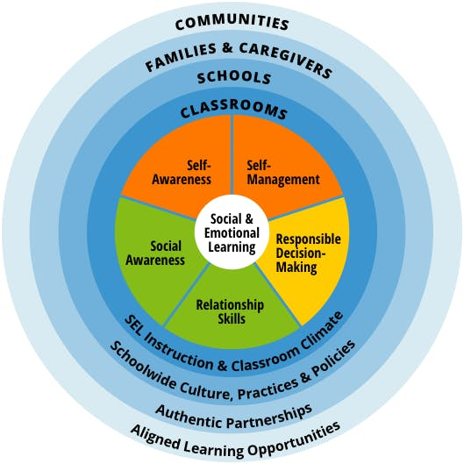


Land Acknowledgment
SEL Student Implementation | Resources & Mapping
Notes:
Regionals

Slide 2

Land Acknowledgment
SEL Standards | National & State
Indicators of Schoolwide SEL
SEL in the Classroom
Self-Assessment
WA SEL Standards, Benchmarks & Indicators
One-Pager
Notes:
Regionals

Slide 3
Land Acknowledgment
RULER Roll-Out Phases | Brief Recap
Readiness & Planning Phase | Winter 2021 (secondary), Spring 2022 (elementary)
During this phase, district and school leaders will be learning about the benefits of emotional intelligence and the time and resources RULER requires.
A structured a plan for allocating resources helps meet these needs over time.
Staff Personal & Professional Learning | 2022-2023
School faculty and staff are introduced to RULER principles and tools. They have the opportunity to practice with skill-building activities in preparation for use with students. This way, the adults in the school are practicing the tools and skills before teaching them to students.
Classroom Implementation & Family Engagement | 2023-2024
Students and their families are formally introduced to RULER principles and tools, including skill-building activities for school and home.
Sustainability & Innovation | 2024 → beyond
RULER principles and tools are embedded into school and district policies and practices, including mission statements, curricula, staff/faculty professional development, and behavioral support plans.
Notes:
Regionals

Slide 4
Note to High Schools | SEL Vertical Alignment
Elementary
Unit 1: Growth Mindset & Goal Setting
Unit 2: Emotion Management
Unit 3: Empathy & Kindness
Unit 4: Problem Solving
Middle School
Unit 1: Mindset & Goals
Unit 2: Recognizing Bullying & Harassment
Unit 3: Thoughts, Emotions & Decisions
Unit 4: Managing Relations & Social Conflict
NOTE: EPS students have been entering high school with SEL instruction through the Second Step curriculum. Pre-pandemic, this was taught by counselors. Since 2021-22, the instruction to students has transitioned to teachers.
Notes:
Regionals

Slide 5
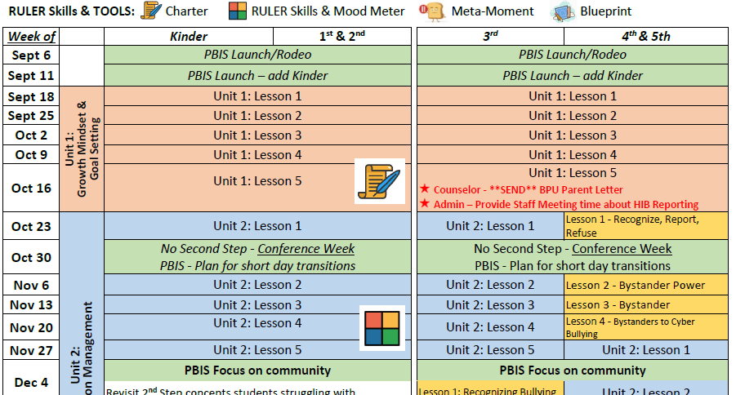
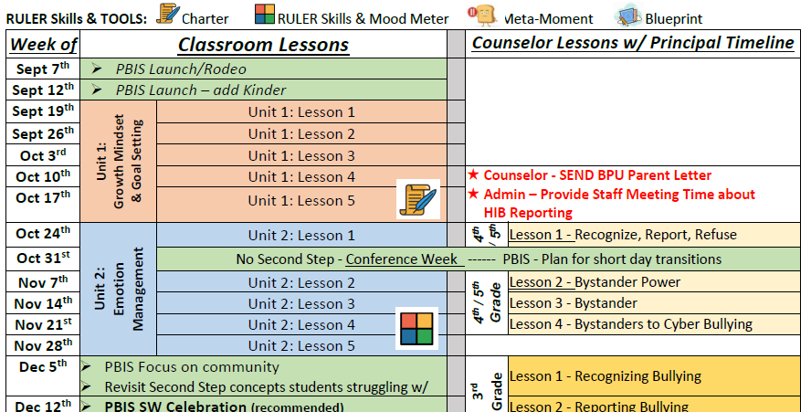
Elementary | RULER & 2nd Step Pacing Guide Suggestions
2 VERSIONS:
CPU/BPU counselor lessons
replace weekly instruction
concurrent w/ weekly instruction
LINK
https://docushare.everett.k12.wa.us/docushare/dsweb/Get/Document-129259/ES%20-%20Integrated%20SEL%20Curriculum%20Map%202023-24.pdf
Notes:
Regionals

Slide 6
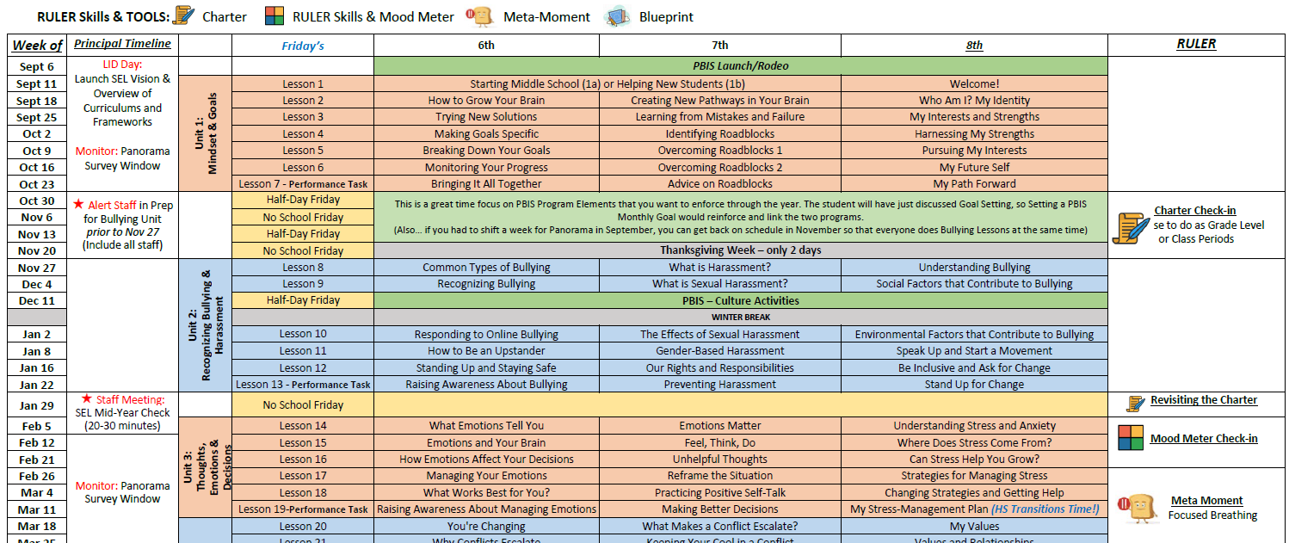
Middle School | RULER & 2nd Step Pacing Guide Suggestions
LINK
https://docushare.everett.k12.wa.us/docushare/dsweb/Get/Document-129258/MS%20-%20Integrated%20SEL%20Curriculum%20Map%202023-24.pdf
Notes:
Regionals

Slide 7
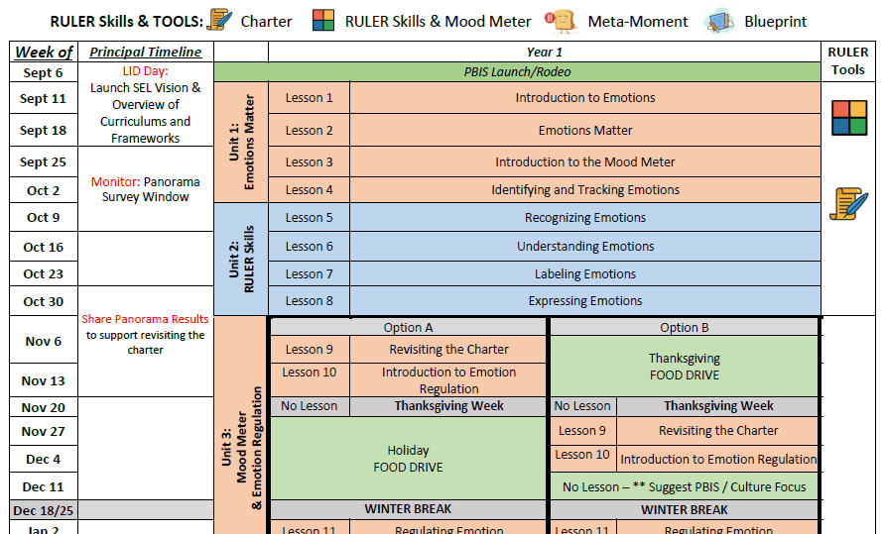
High School | RULER Pacing Guide Suggestions
LINK
https://docushare.everett.k12.wa.us/docushare/dsweb/Get/Document-129260/HS%20-%20Integrated%20SEL%20Curriculum%20Map%202023-24.pdf
Notes:
Regionals

Slide 8
Land Acknowledgment
ES | SEL Staff Check-In’s & Training During the Year
HB 1539 – Erin’s Law
When districts teach a specific child sexual abuse unit, they must also:
Provide timely annual teacher training around responding to students who report
Provide parent notification 30 days prior to beginning lesson(s), and an opportunity to opt out of the lessons by written request
3204P – EPS HIB Procedure
Requirements from Section E
Dissemination
Education
Training
Prevention Strategies
DATES:
LID (Aug. 30-31)
3-5 | Mid-October in preparation for BPU & HIB reporting
K-2 | Early January in preparation for CPU
Mid & End of year all-staff RULER/SEL check-in
Notes:
Regionals

Slide 9
Land Acknowledgment
MS & HS | SEL/RULER Staff Check-In’s & Training During the Year
MS NOTE: Alert all staff in preparation for the Bullying Unit prior to November 27
DATES:
LID (Aug. 30-31)
Mid-year (semester transition)
End-of-year (next steps & celebrations)
Notes:
Regionals

Slide 10
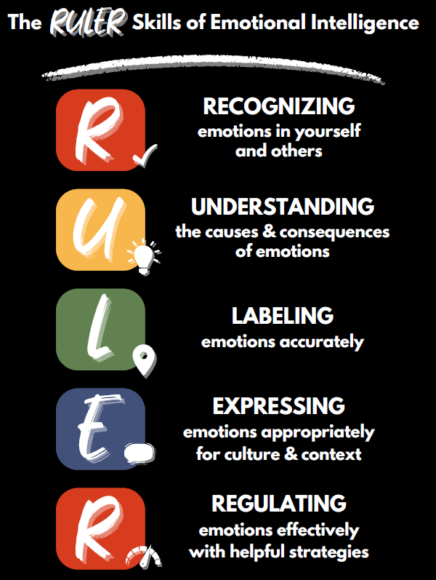
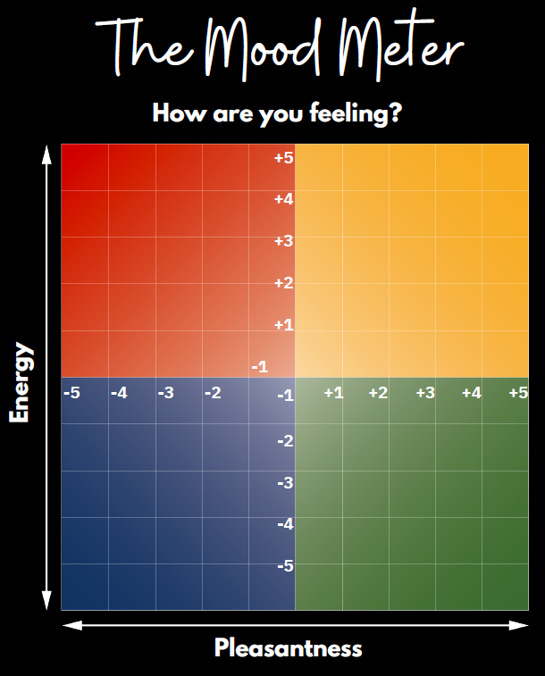
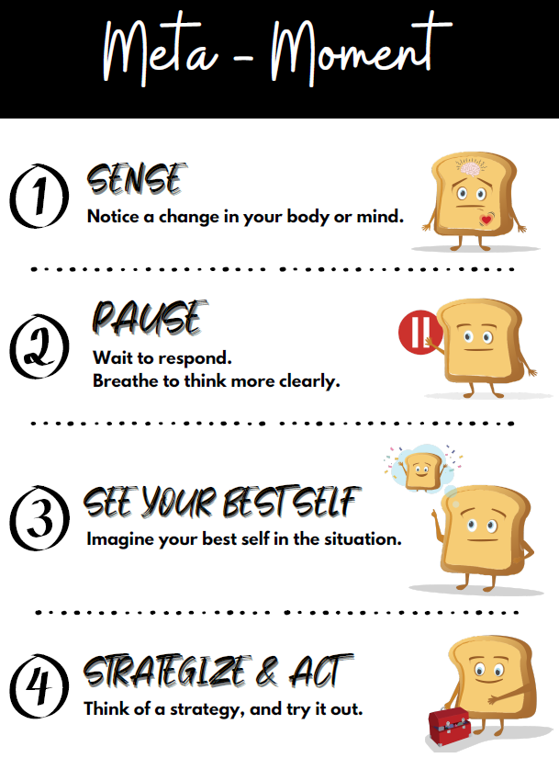
Land Acknowledgment
RULER Posters
Notes:
Regionals

Slide 11
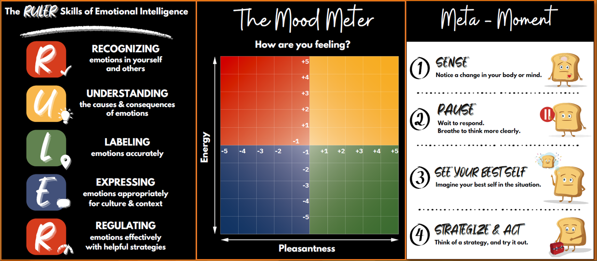
Land Acknowledgment
RULER Posters
Click to access the
RULER poster order form
for your school & classrooms
You may choose:
  Type(s)
  Size(s)
  Quantities of each
Link | https://forms.office.com/r/bkHQ3krre5
Notes:
Regionals

Slide 12
Land Acknowledgment
RULER & Second Step Dashboard Maintenance
The RULER and Second Step dashboards will be updated centrally by August 25
  To include access for staff new to your school
  To remove staff who are no longer at your school (no longer in EPS or moved to another EPS school)
Changes during the year to staff dashboard access
  Will be maintained by each school (office manager or designee)
  Please notify Dave Peters if your office manager would appreciate a training or refresher
Notes:
Regionals

